Slide 1
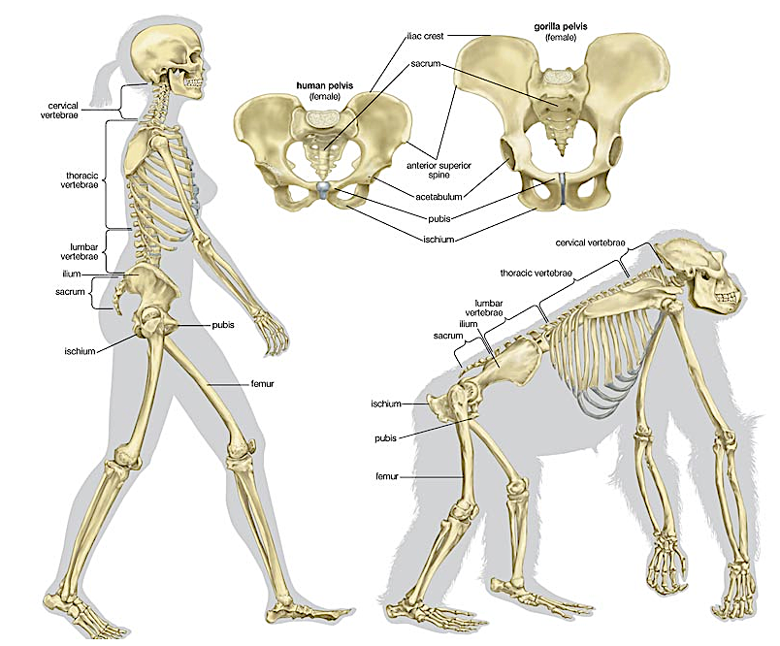
Quadrupedal vs bipedal primate

Slide 2
Hominid Evolutionary Trends

Slide 3
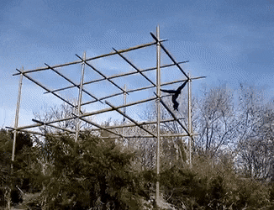
The Apes
Anatomical features and habits:
Well adapted to an arboreal (tree-dwelling) lifestyle
Brachiating (swing underneath from branch to branch)
Some mainly ground dwelling and quadrupedal (e.g. gorilla)
Arms longer than legs
Flattened nose
Bony eye ridges
No tail

Slide 4
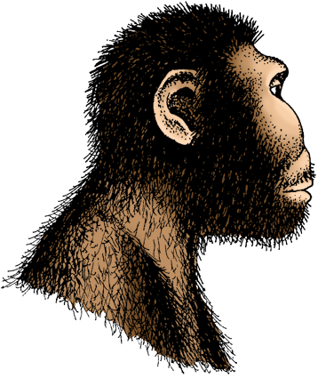
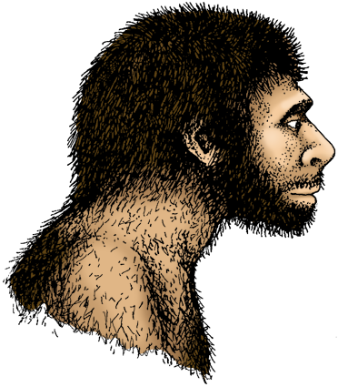
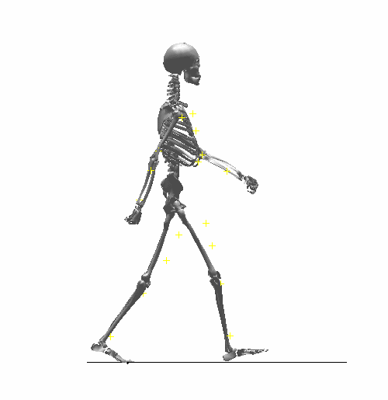
The Hominids
Characteristics:
Bipedal with modified feet, thigh bone, pelvis, and spine
Large cerebral cortex (forebrain)
Reduced canines (and teeth in general)
Prominent nose and chin, reduced eye ridges
Reduced/short body hair to assist cooling
Highly sensitive skin
Complex social behavior
Paranthropus boisei
Homo neanderthalensis

Slide 5
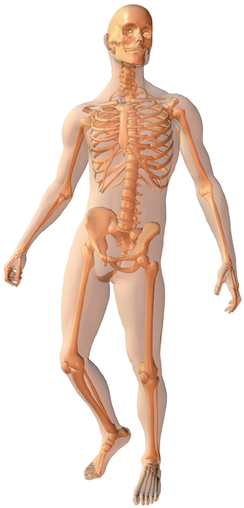
Locomotion – adaptations to bipedalism
Spine Shape
Cervical curve – brings vertebral column directly under the COG of the skull
Thoracic curve – brings COG directly over the feet
Lumbar curve - vertebrae are wedge-shaped forming a forward jutting curve – improves balance in upright position
Position of Foramen Magnum: Located more centrally under the skull, so that the skull is balanced on the spine
Femur
Longer and angled inwards from the hips so that the knees nearly touch. This “carrying angle” assists in positioning the upper body over the centre of gravity.
Pelvis Shape: Short and broad, for attachment of large, powerful muscles for walking. Pelvis has become more 'bowl-shaped' to provide support for the organs of the torso. *
Knee Joint:
Bottom of the femur has a enlarged hinge on the outside of the knee joint (called the lateral condyle). Allows weight to be transmitted down the outside of each leg.
Shape of Foot: The anatomy of the foot has changed to become a platform
Toes are short, with big toe forward thrusting. Inner side of the foot is elevated into an arch to provide shock absorption.

Slide 6
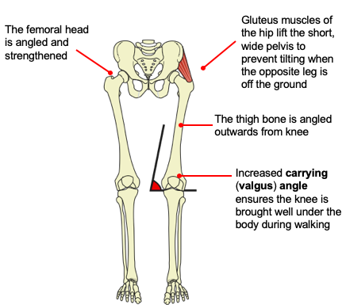
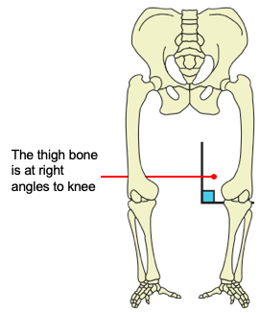
Carrying angle
Gorilla legs
Human legs

Slide 7
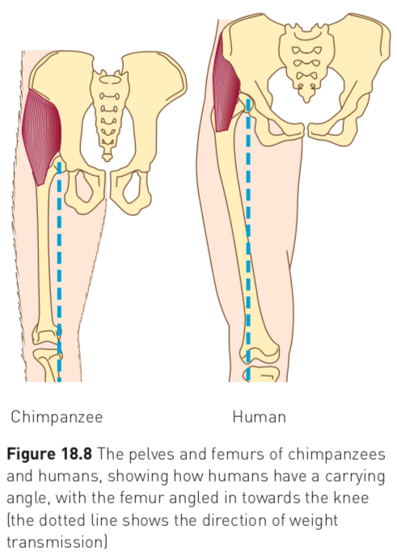
Carrying angle
Allows for greater stability when walking as it enables the body to be rotated about the lower leg and foot
Weight distribution remains close to the central axis
Enables humans to have a striding gait
  Walking in way that the hip and knee are fully extended

Slide 8
Knee joint
Weight of body is transmitted to the lateral condyle (outer hinge)
It is larger and stronger compared to the medial condyle (inner hinge)

Slide 9
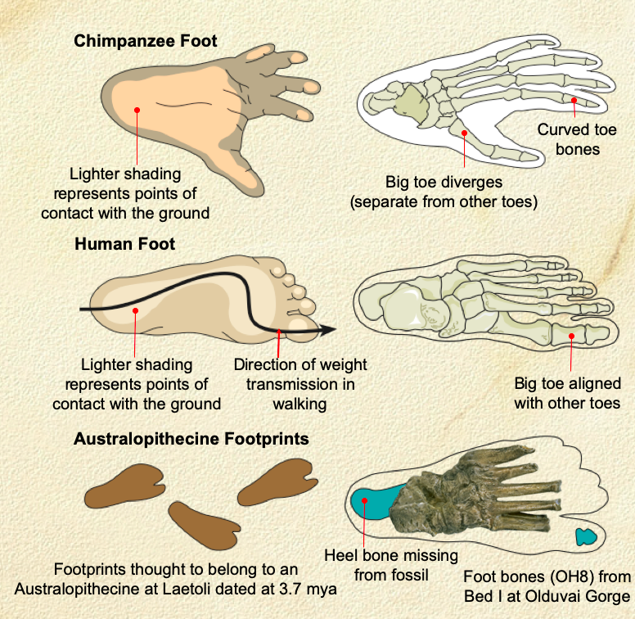
The foot
Toes became reduced in length and are no longer curved.
The big toe is no longer opposable
Lost its grasping ability (prehensility)
Metatarsals are shaped in a way which forms:
  Longitudinal arch
  Transverse arch (unique to humans) converts the foot into a spring allowing it to transmit the stresses of walking and improve walking efficiency

Slide 10
Prognathism - forward jutting/protruding jaw
Reduction in prognathism in higher order primates
Adaptation to bipedalism
  Enables skull to balance on top of the vertebral column
  Reduction in neck muscles to support skull
Causes
Reduction in teeth size, teeth number
Change in diet
Development of speech

Slide 11
Other trends features in hominid evolution

Slide 12
Zygomatic arch
Reduction in size and prominence of the zygomatic arch
A bony arch just behind the cheeks
Provide a gap for the temporal muscles to pass through
They are much larger in apes to accommodate much larger temporal muscle

Slide 13
Brow ridge
Reduction of the prominence of a brow ridge in higher order primates

Slide 14
Sagittal crest
Present in bipedal hominids
Paranthropus (Australopithecus) robustus
Provided attachment for strong jaw muscles for chewing

Slide 15
Australopithecus vs Homo sapiens

Slide 16
ATAR 2017
All bipedal hominids have many features in common. However, the species of genus Australopithecus and genus Paranthropus display differences from the species of genus Homo.
Identify four differences that may be observed in the various species of Australopithecus and Paranthropus when compared with those species that belong to genus Homo. For each of the four differences identified, state how it differs from the genus Homo.
(8 marks)

Slide 17
